Slide 1

PRASAD
Home About Resume Projects My Blogs Contact
HELLO !
I’m
Prasad
Sawant
Fullstack We Developer
HIRE ME
MY WORK

Slide 2
M
"Join me to bring your projects to life, leveraging my expertise in HTML, CSS, Bootstrap , jQuery, JavaScript, C# and ASP.NET MVC."
MY SKILLS
72%
72%
72%
72%
HTML
CSS
JavaScript
C #
72%
72%
72%
72%
Bootstrap
jQuery
ASP.NET
MSSQL

Slide 3

A
ABOUT ME
Content for about me

Slide 4
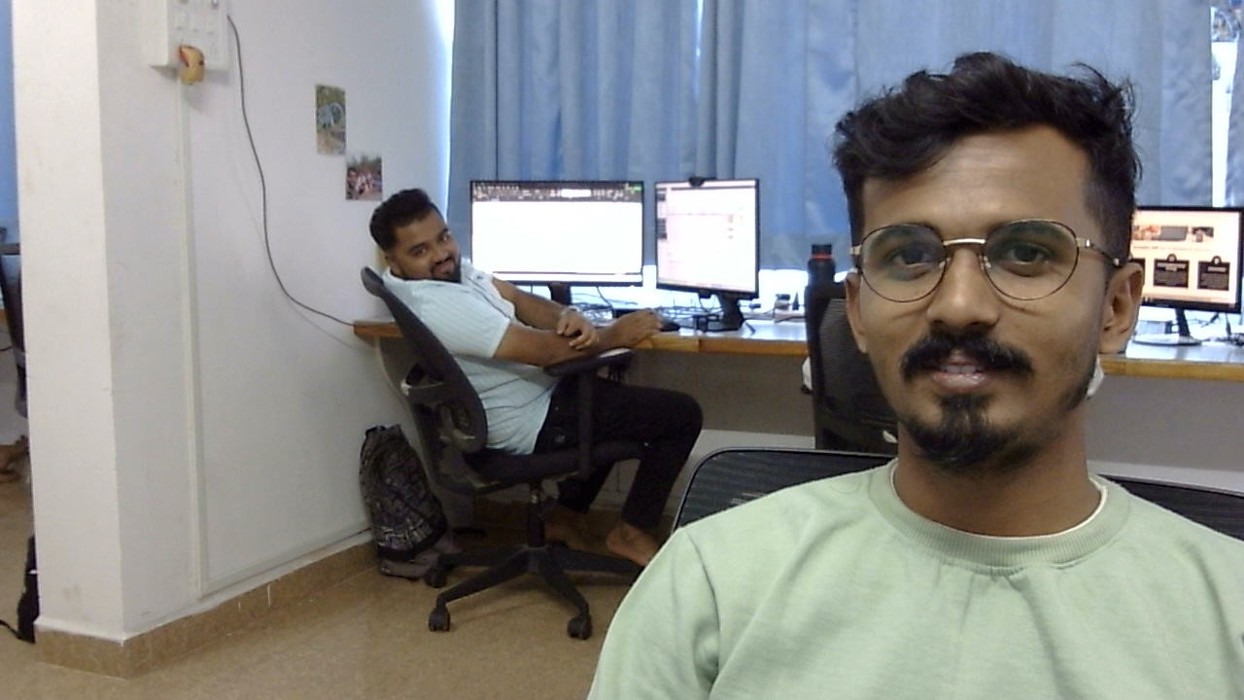
B
See More Blogs
"Join me to bring your projects to life, leveraging my expertise in HTML, CSS, Bootstrap , jQuery, JavaScript, C# and ASP.NET MVC."
MY BLOGS
<
>
"Join me to bring your projects to life, leveraging my exper
"Join me to bring your projects to life, leveraging my exper
"Join me to bring your projects to life, leveraging my exper
See More
See More
See More

